Slide 1
Computer networks project-2 three-way handshake in tcp

Slide 2

Transmission control protocol
TCP is a connection-oriented protocol that facilitates reliable communication between devices over a network.

Slide 3
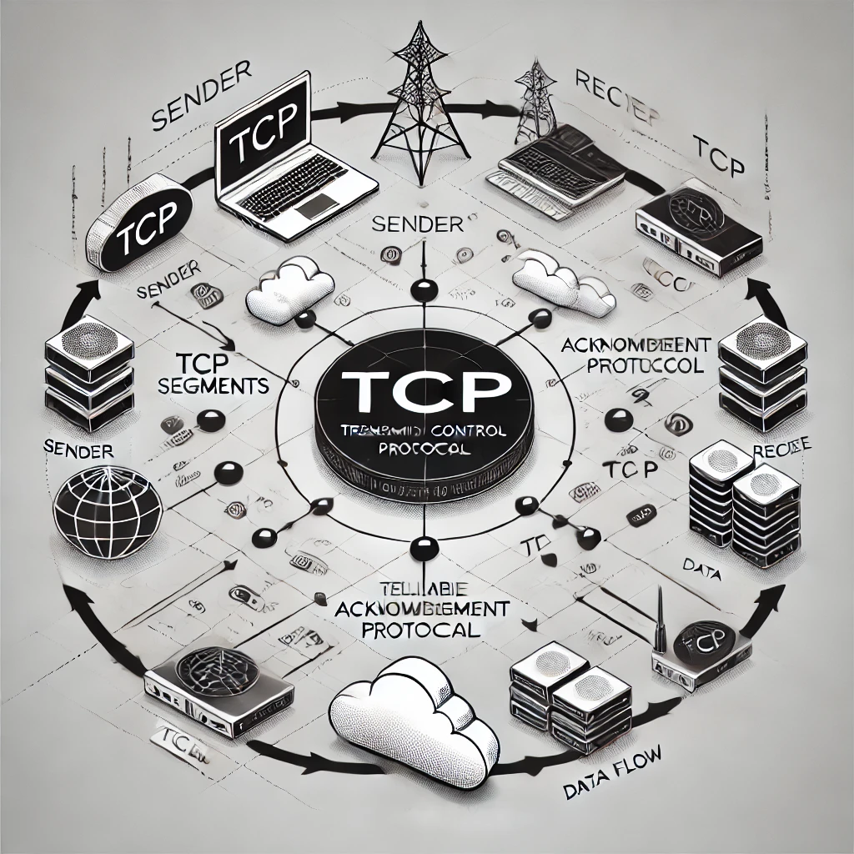
Characteristics of TCP:
Connection-Oriented: Establishes a connection before data transmission.
Reliable Delivery: Ensures accurate
and ordered data delivery.
3.Flow Control: Regulates data transmission rate to prevent overload.
4.Congestion Control: Adjusts transmission rate based on network conditions.

Slide 4

Reliable data transmission
Three-Way Handshake: Establishes a synchronized connection between client and server.
Error Detection and Correction: Uses checksums and retransmits lost packets to ensure data integrity.
Sequence Numbers and Acknowledgments: Assigns sequence numbers for packet ordering and sends ACKs to confirm receipt.
Flow and Congestion Control: Regulates transmission rates to prevent overload and adjust for network conditions.

Slide 5
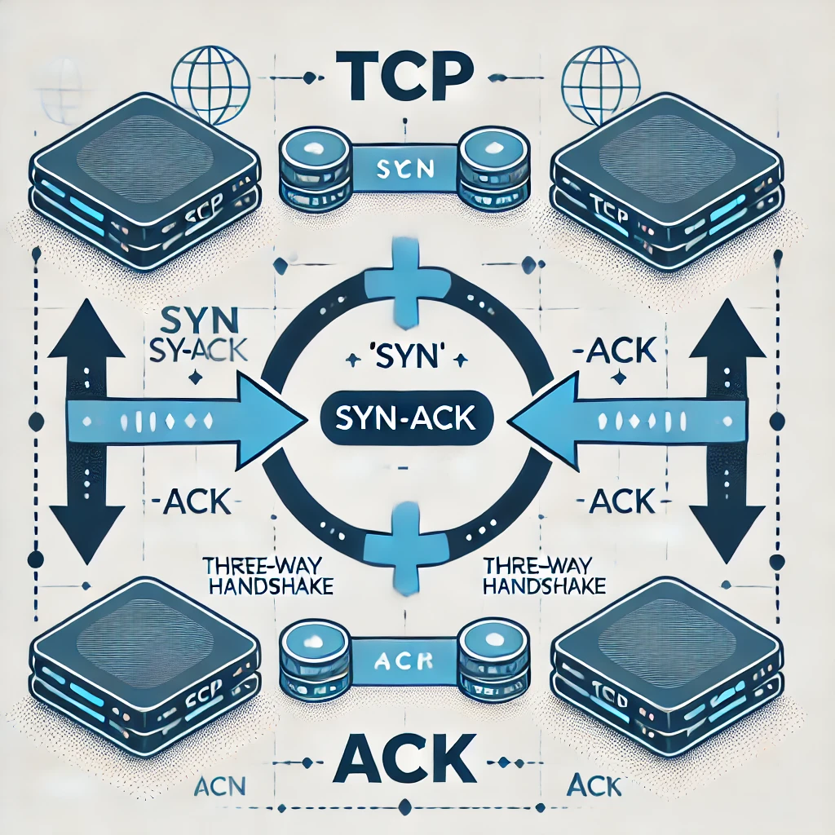
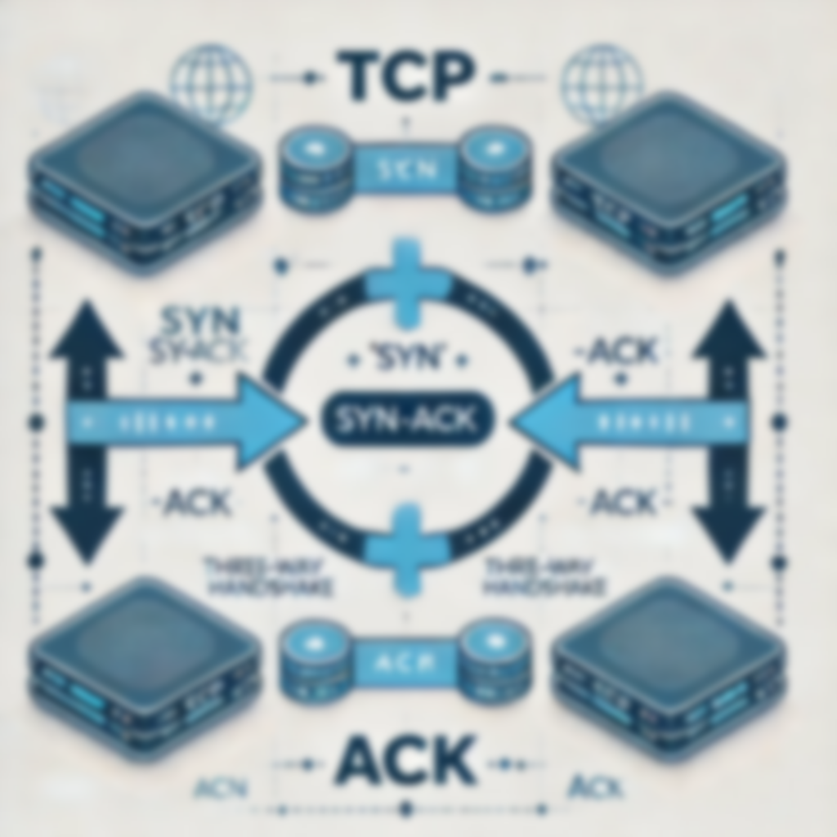

Three-way handshake
Definition:
The three-way handshake is a method used in the Transmission Control Protocol (TCP) to establish a reliable connection between a client and a server.
It involves a sequence of three steps—SYN, SYN-ACK, and ACK—that synchronize the communication parameters and ensure both parties are ready to exchange data.
This process is essential for ensuring reliable and ordered data transmission over a network.
Purpose :
To ensure both parties are synchronized and ready for data transmission, establishing a reliable communication channel.

Slide 6
Steps involved in three-way handshake
SYN (Synchronize)
The client initiates the connection by sending a SYN packet to the server, which includes the client's Initial Sequence Number (ISN). This signals the server that the client wants to establish a connection.
SYN-ACK (Synchronize-Acknowledge)
The server responds with a SYN-ACK packet, acknowledging the client's SYN. This packet contains the server's own ISN and an acknowledgment number, which is the client's ISN incremented by one. This indicates that the server is ready to establish a connection.
ACK- Acknowledge
The client sends an ACK packet back to the server, acknowledging the server's SYN-ACK. This packet includes an acknowledgment number, which is the server's ISN incremented by one. This final step completes the handshake, establishing a reliable connection for data transmission.

Slide 7
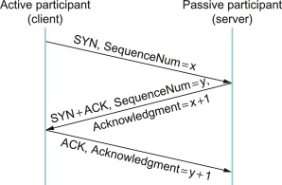
Steps involved in three-way handshake

Slide 8
Importance of three-way handshake
Connection Establishment: Ensures a reliable connection before data transmission.
Synchronization: Aligns sequence numbers for proper data ordering.
Reliability: Confirms both parties are ready to communicate, reducing data loss.
Error Handling: Facilitates error detection and retransmission if needed.
Prevention of Half-Open Connections: Ensures both sides are aware of the connection status.
Flow Control Preparation: Sets the stage for efficient data transmission.
Foundation for Data Transfer: Essential for applications requiring high data integrity.

Slide 9
THANK YOU
Akshaya choudary - 2023000420
Sanjana Dasari - 2023000377
Dirgha Dutta- 2023000335

